Slide 1
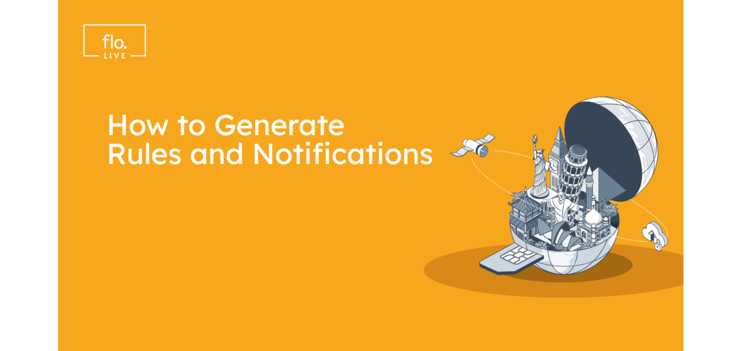
Notes:
Welcome to another Video tutorial from floLIVE.
This Video will focus on floLIVE Connectivity Management Platform Rules and Alerts principles.

Slide 2
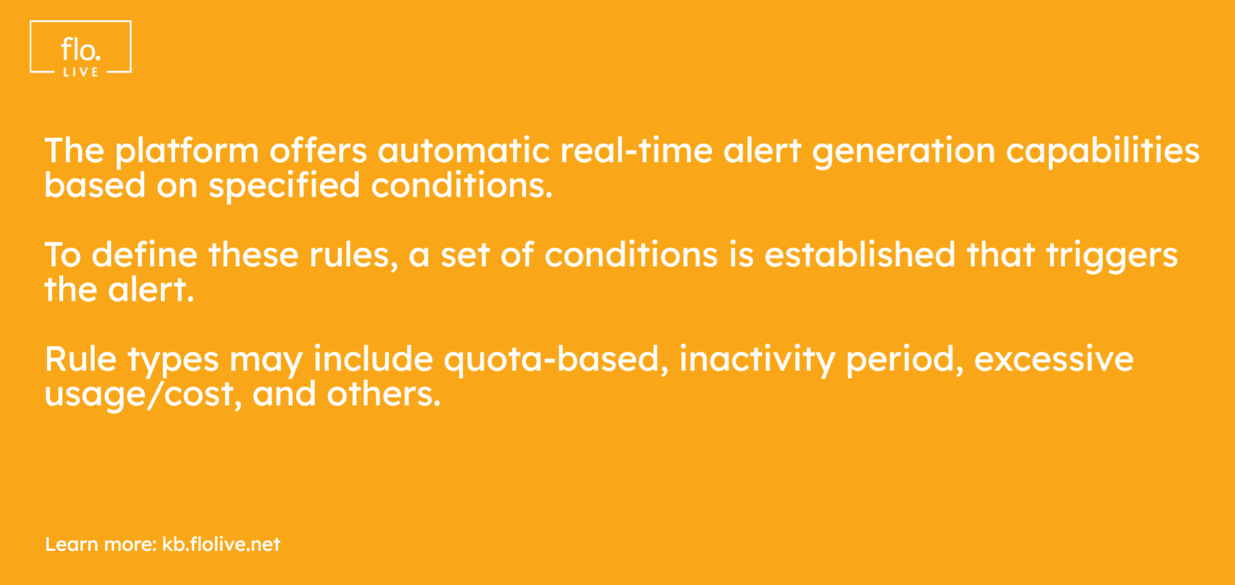
Notes:
The rules and alerts engine allows for the automatic generation of real-time alerts when certain conditions are met by an entity on the platform.
The rules definition includes a set of conditions that once met will trigger an alert from the platform.
Some examples of these conditions include quota-based alerts, connection inactivity alerts, and excessive spending alerts.

Slide 3
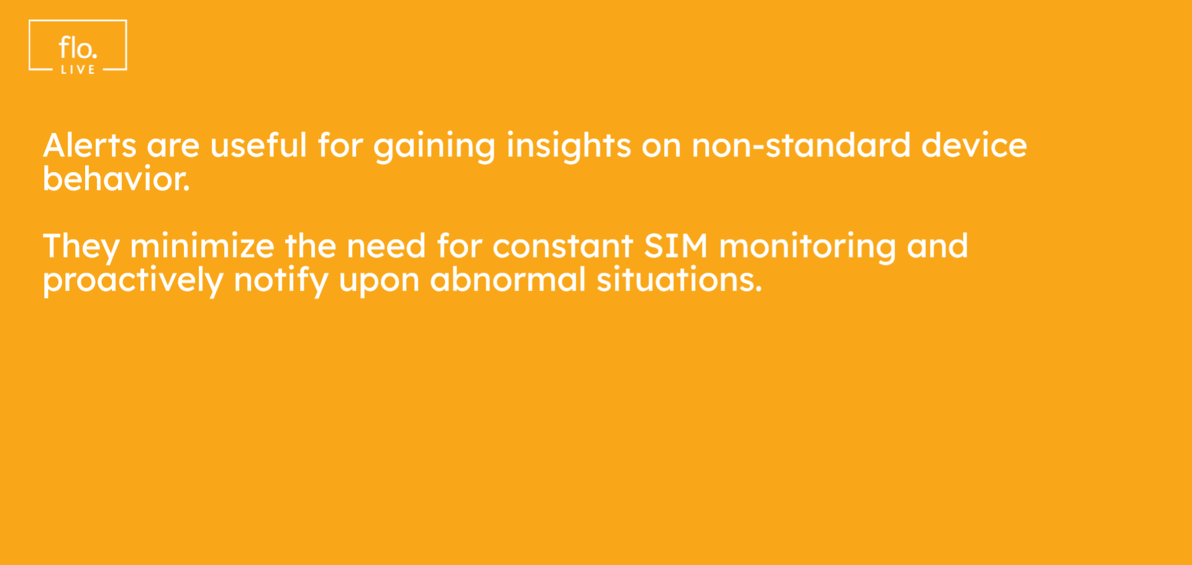
Notes:
Alerts are a useful tool for gaining insights and receiving input on situations that are considered non-standard or unexpected device behavior.
This reduces the need for constant monitoring of SIM behavior, and customers are notified proactively in the event of abnormal or extraordinary situations down to the SIM level.

Slide 4
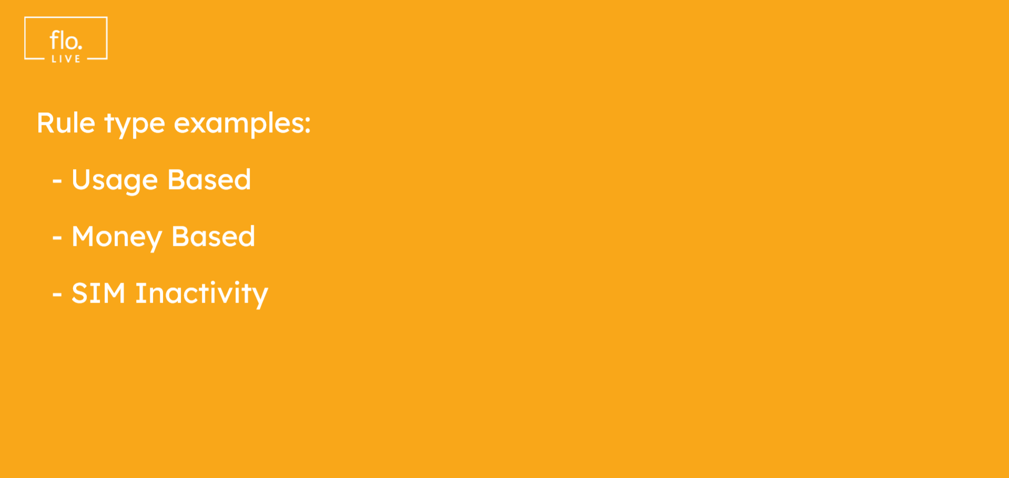
Notes:
In this video we will provide a step-by-step guide on how to create three different types of rules and alerts.

Slide 5
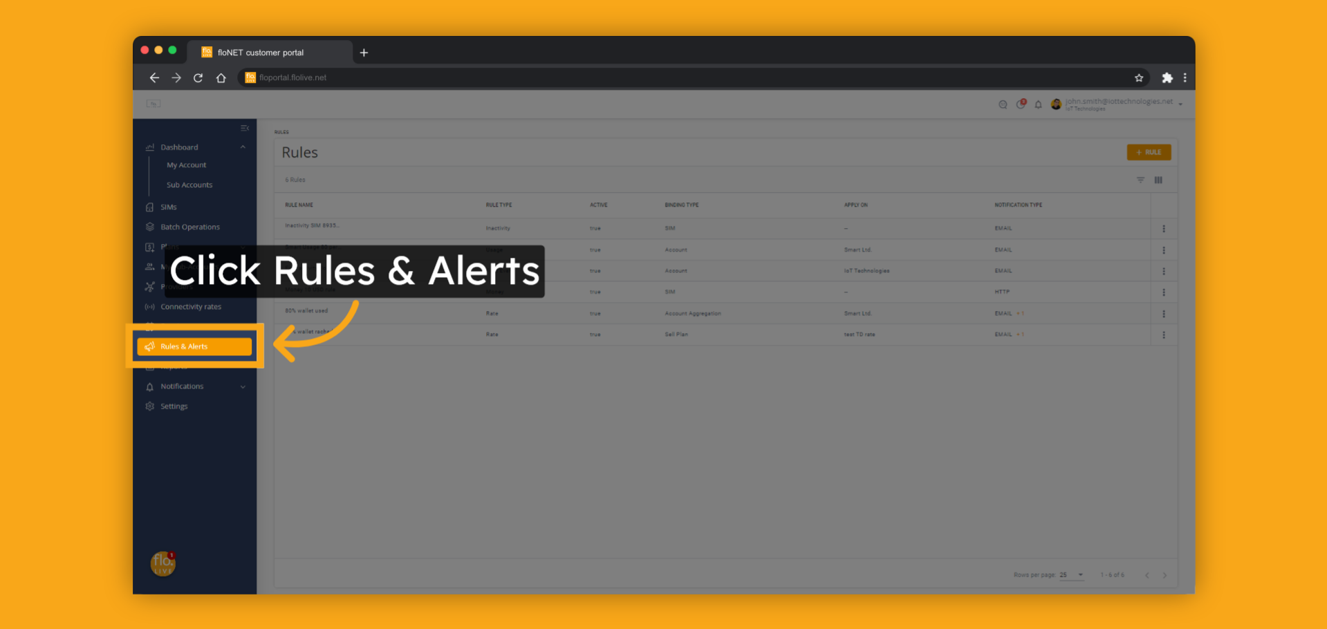
Notes:
To get started , click Rules and Alerts

Slide 6
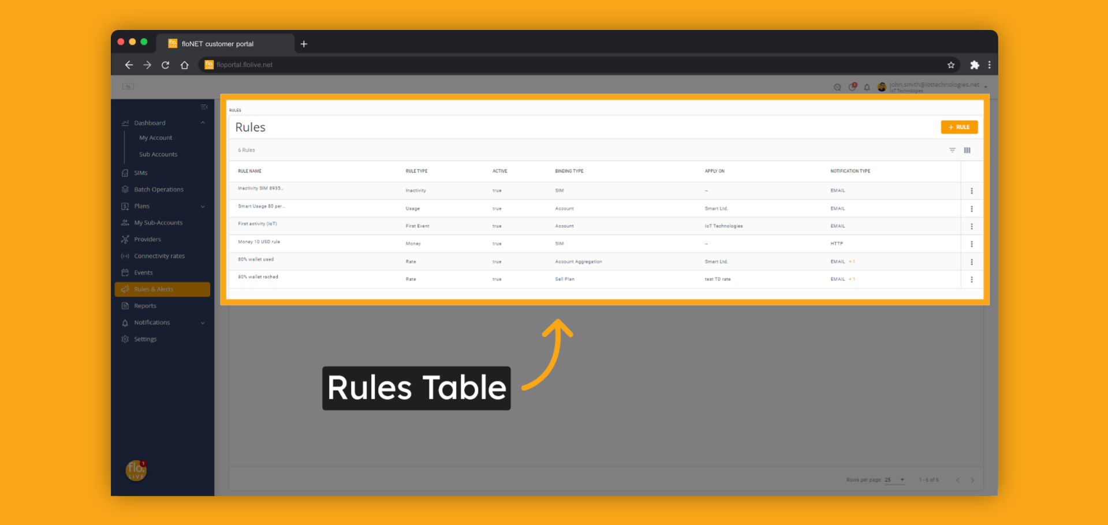
Notes:
The page for rules and alerts shows a table that lists all the rules created for the account.
The table displays the main parameters of each rule, including its name, type, and binding type.
On this page, you can manage all the settings of your rules, such as searching for, creating, editing, or deleting rules.

Slide 7
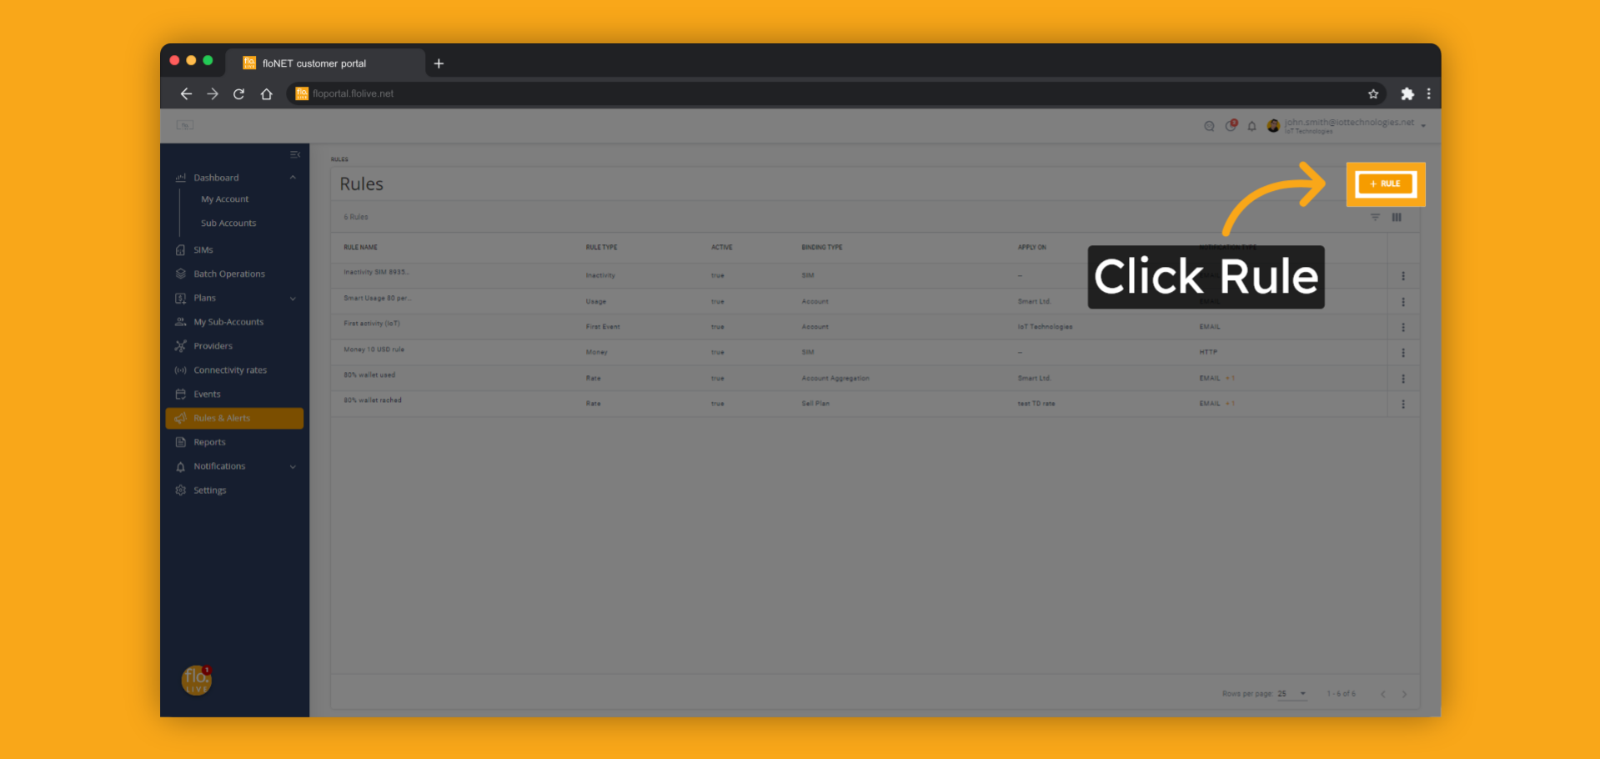
Notes:
Click the rule button to create a new rule.

Slide 8
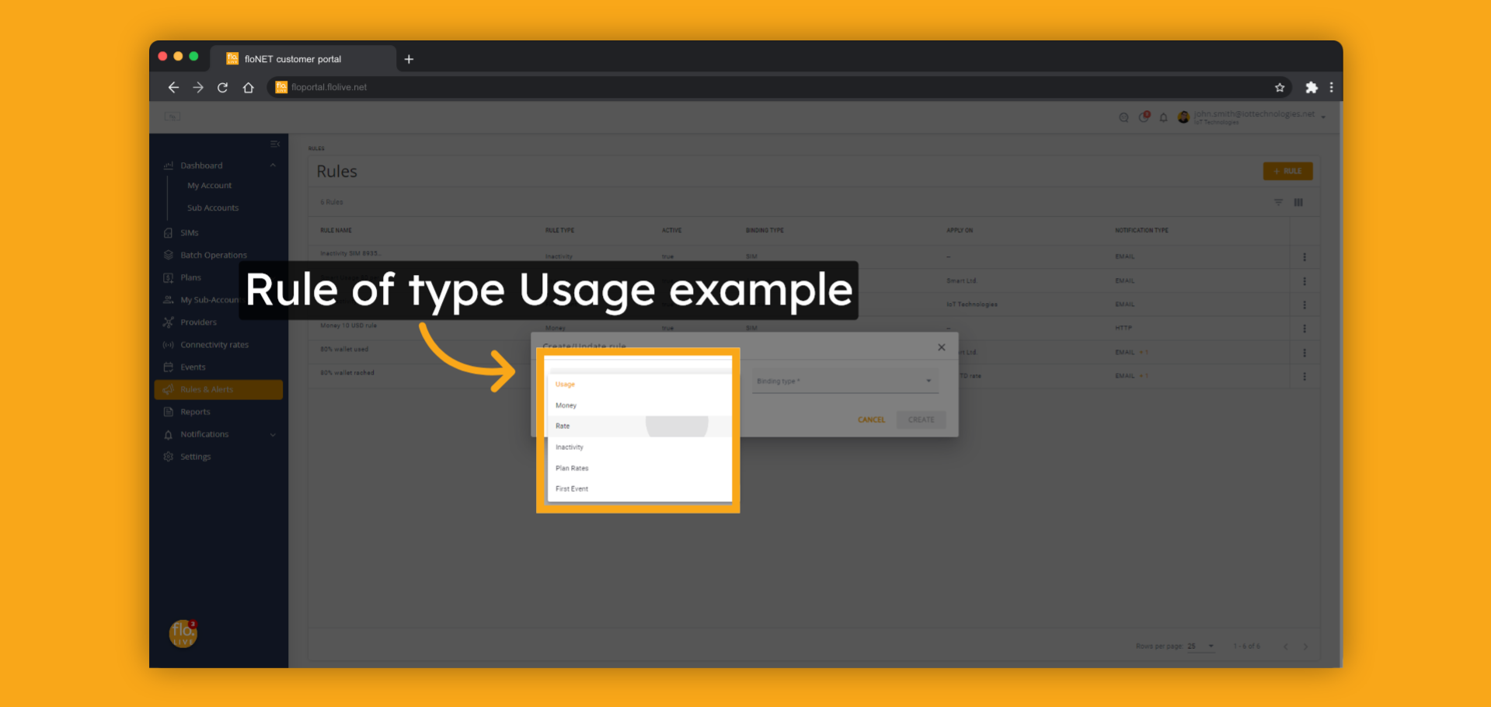
Notes:
Here is an example of how to create a new Usage type rule.
This type of rule will monitor all SIMs on an account and generate an alert for each SIM once its remaining buy plan allowance falls below the defined threshold level.
To get started, simply select the Usage rule type from the available options.

Slide 9
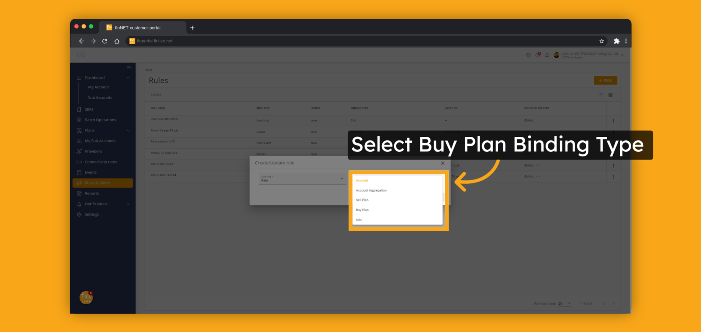
Notes:
The Rule are based on one of several binding types:
Accounts - applies to each individual SIM of the account.
Account aggregated - applies to the aggregated consumption of all SIMs of the account.
Buy Plan - applies to the plan attached by the parent account on a SIM level.
Sell Plan - applies to the plan attached by your account on a SIM level.
SIM - applies to a specific SIM.
In this example we will use the Buy Plan binding type.

Slide 10
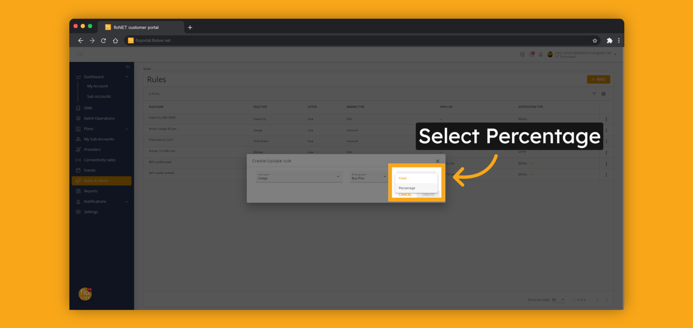
Notes:
Usage rule has two calculation modes.
Fixed - sets the fixed amount of remaining allowance for an alert.
Percentage - sets the level of remaining allowance for an alert.
In this example we will use the percentage option.

Slide 11
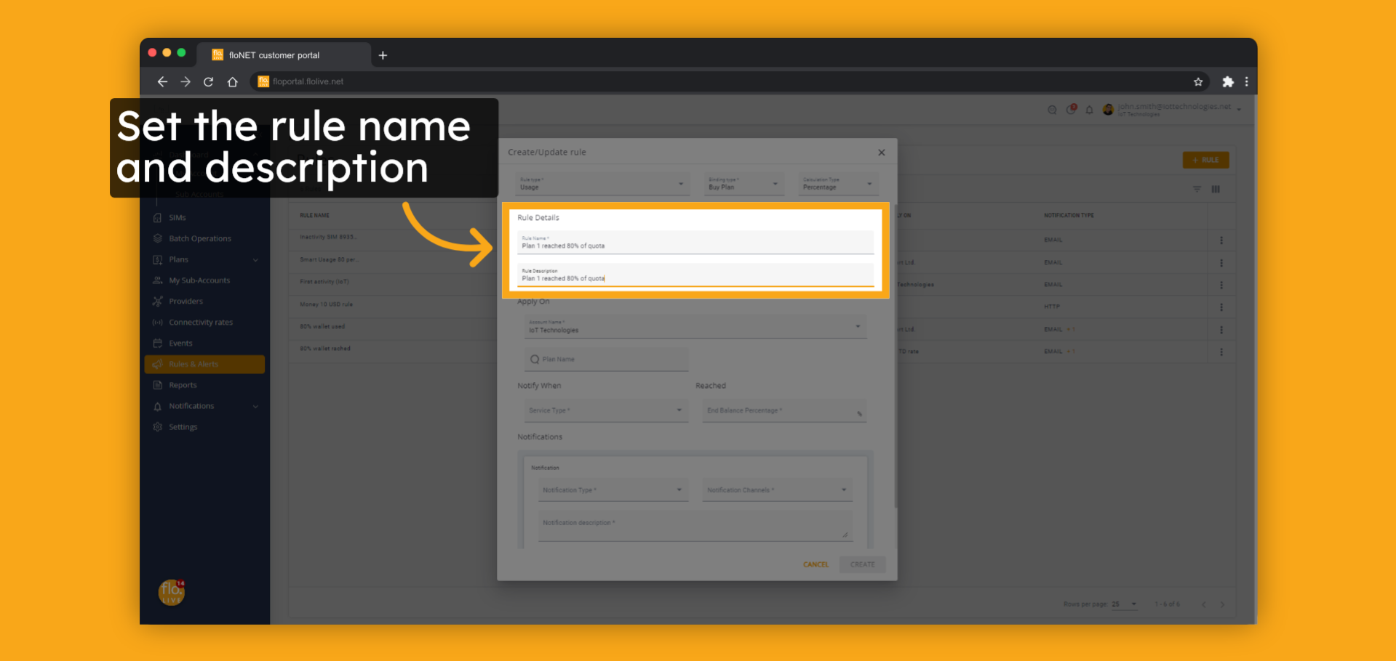
Notes:
Set the rule name and description

Slide 12
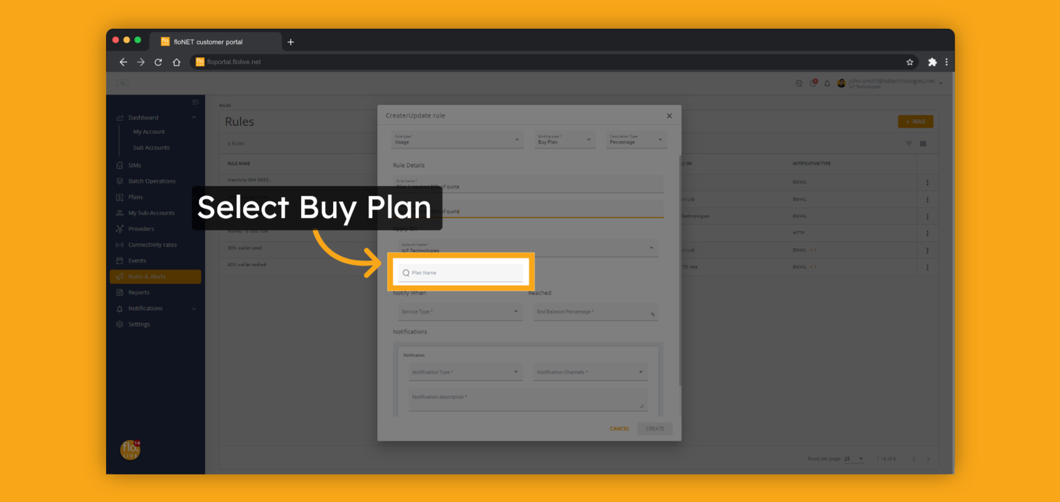
Notes:
Select the buy plan of this rule.
Start typing the plan name for a quick search.

Slide 13
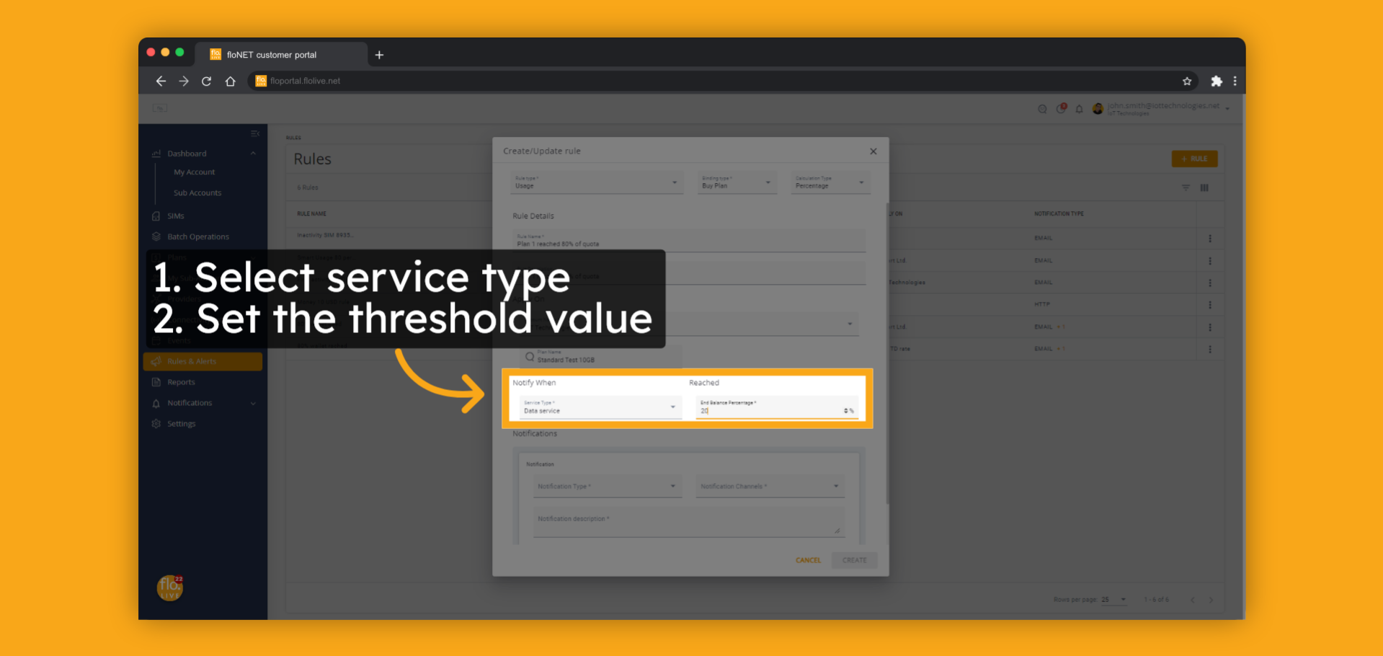
Notes:
Select the service type the rule applies to.
The available options are Data or SMS.
Next, set the percentage threshold value.

Slide 14
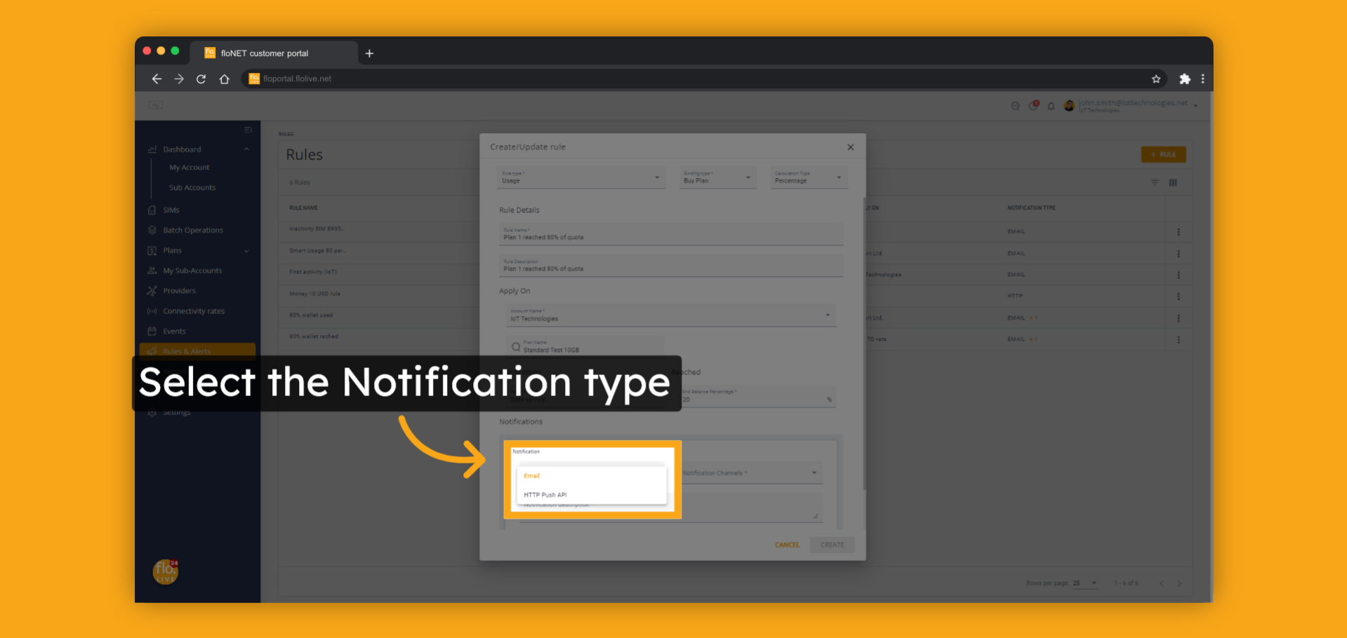
Notes:
The Notification section allows you to choose one or more notification destinations.
You can select either Email or HTTPS Push API as the notification option.
In this example, we will use the Email notification option.
If you want to learn more about the Notification Channel module, please visit our floLIVE knowledge center at kb.floLIVE.net.

Slide 15
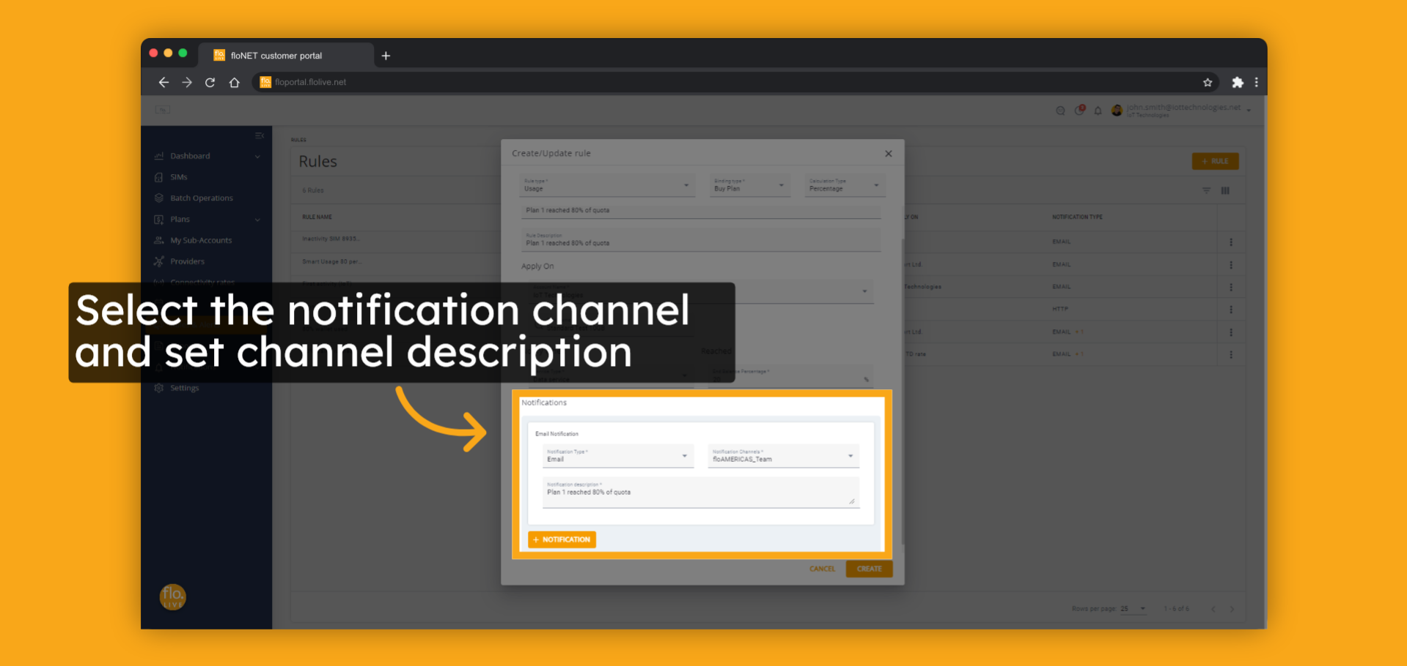
Notes:
Select the notification channel and provide a user-friendly description for the notification.
Note that notification channels must be created beforehand.

Slide 16
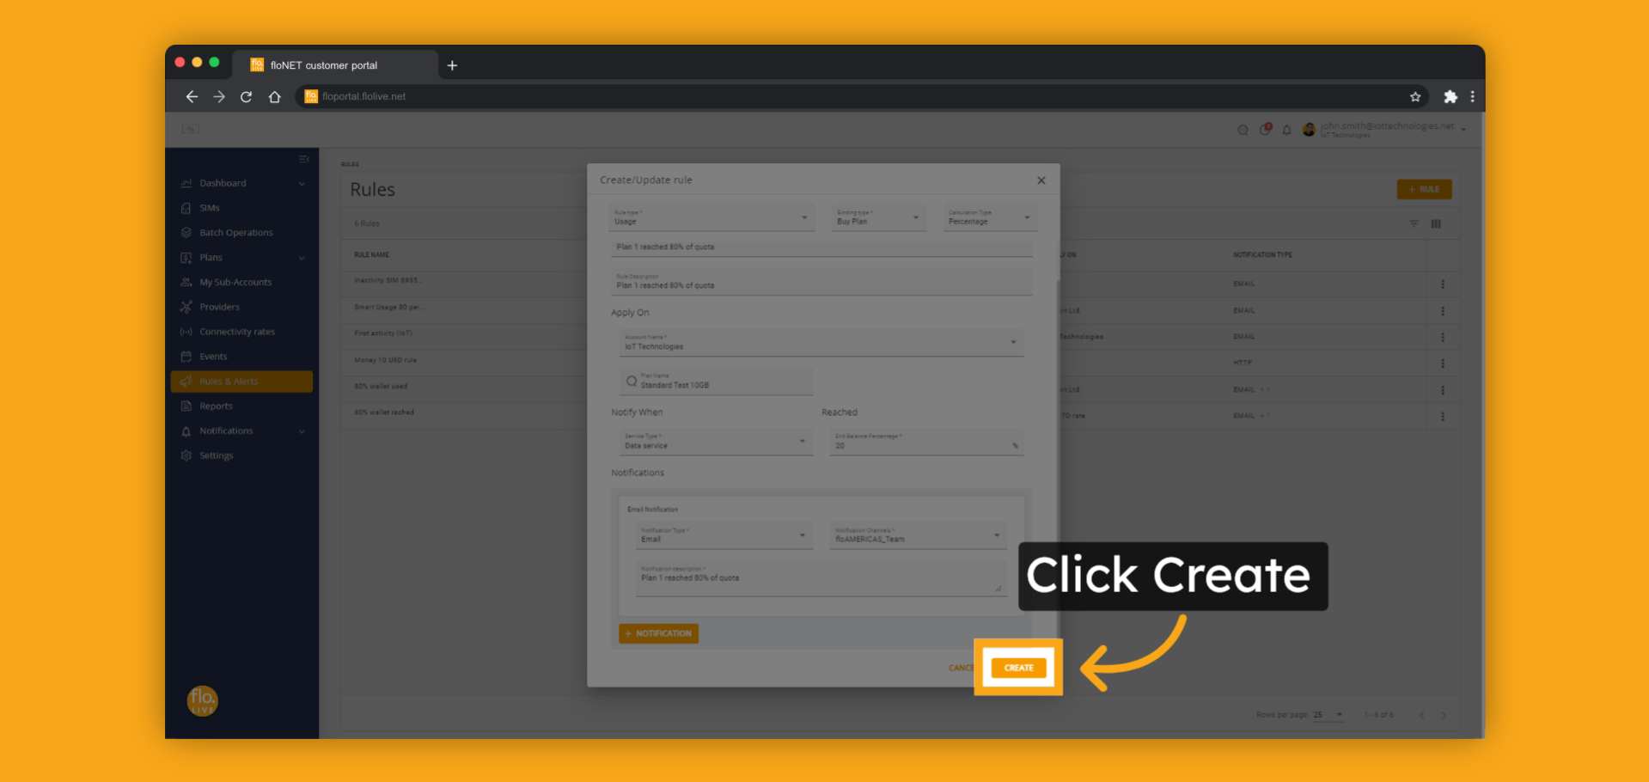
Notes:
Press the Create button to create the rule.
The rule shall start to be operational immediately.

Slide 17
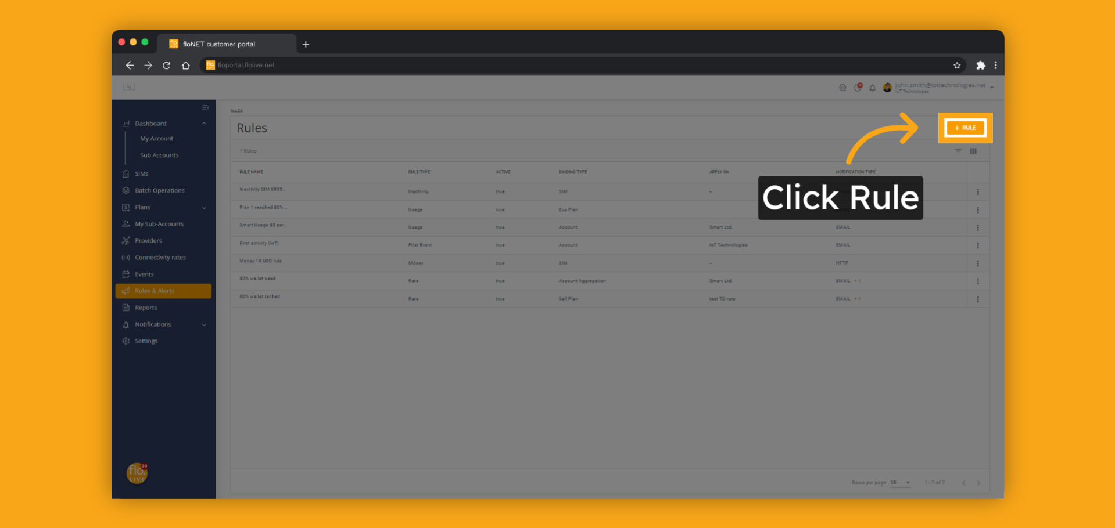
Notes:
Let's review a rule type called Rate.
This rule monitors all sims in the account and generates an alert when a SIMs usage or expenses reach a defined threshold.
To begin, click the new rule button.

Slide 18
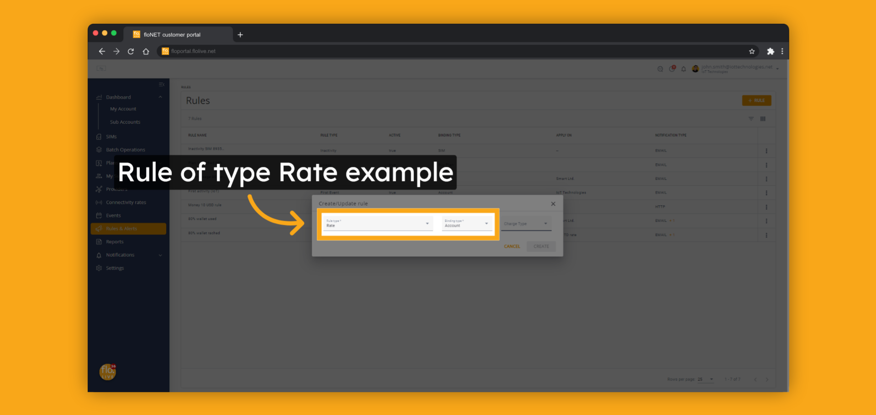
Notes:
Select Rate as the rule type and Account as the binding type.

Slide 19
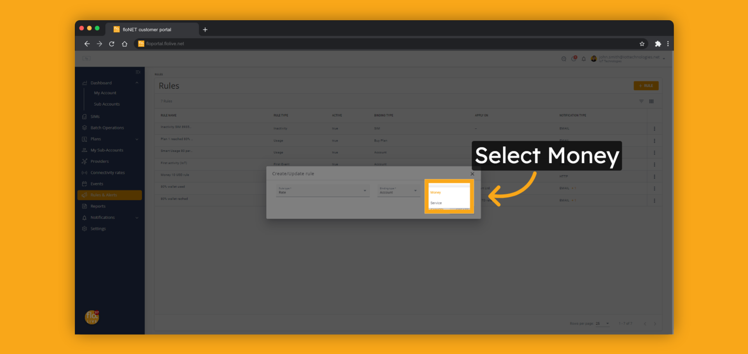
Notes:
Select the option Money from the charge type select option.

Slide 20
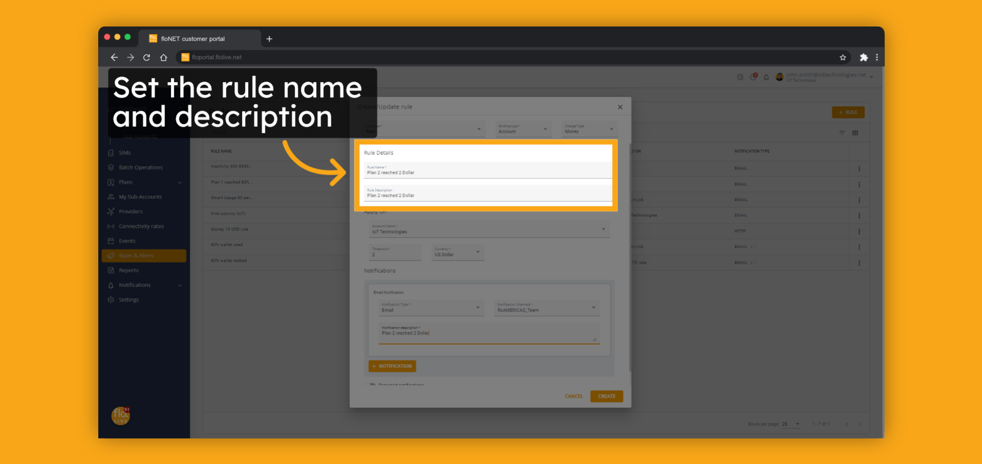
Notes:
Set the rule name and description.

Slide 21
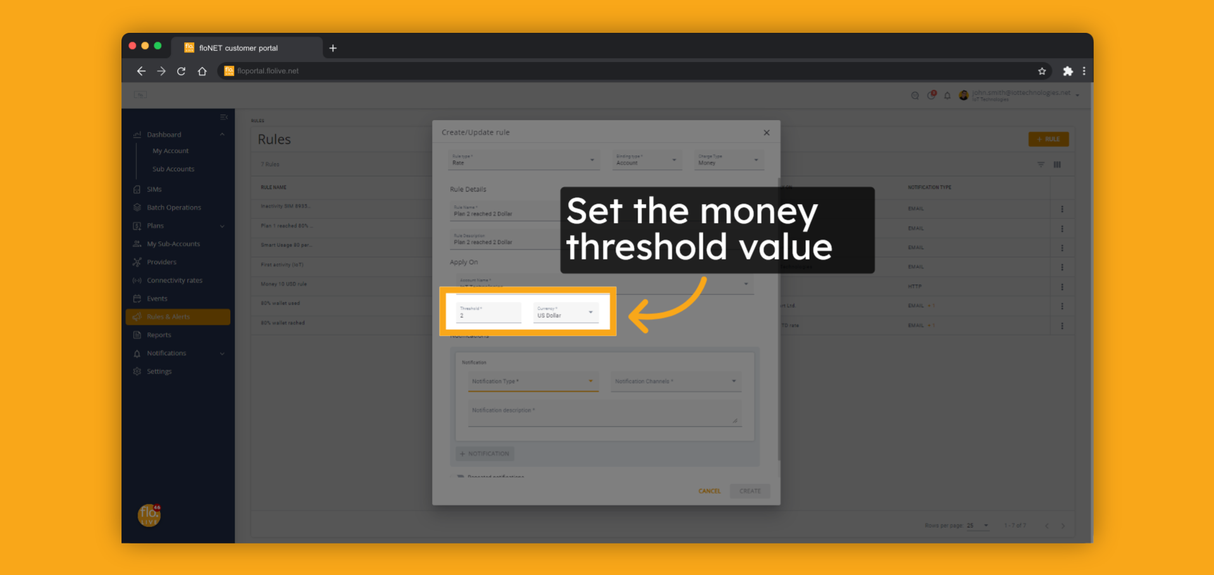
Notes:
Set the money threshold value.

Slide 22
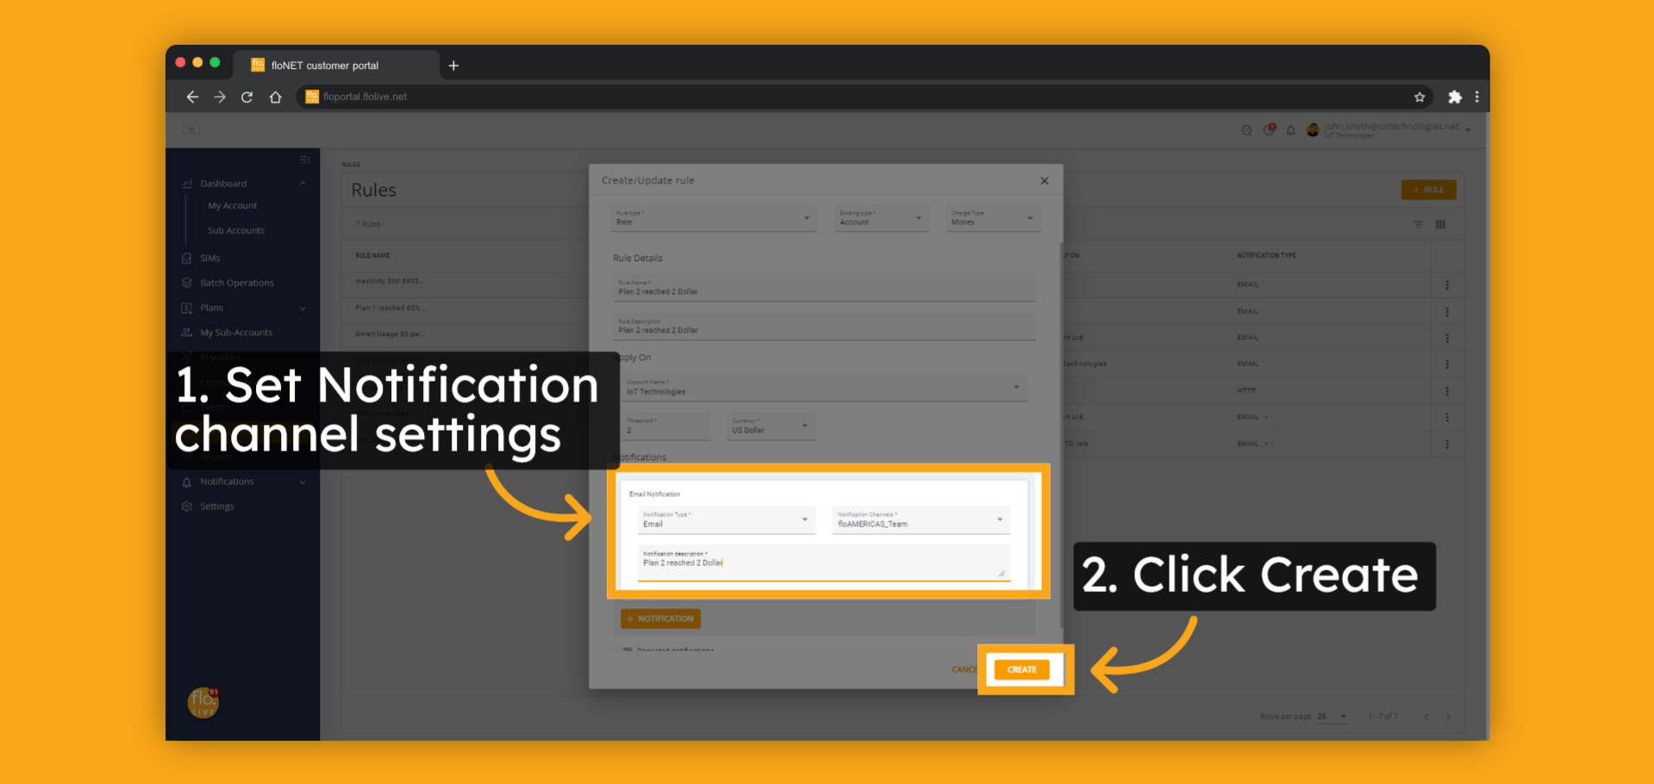
Notes:
Select the notification options and click the Create button.
The rule will become operational immediately.

Slide 23
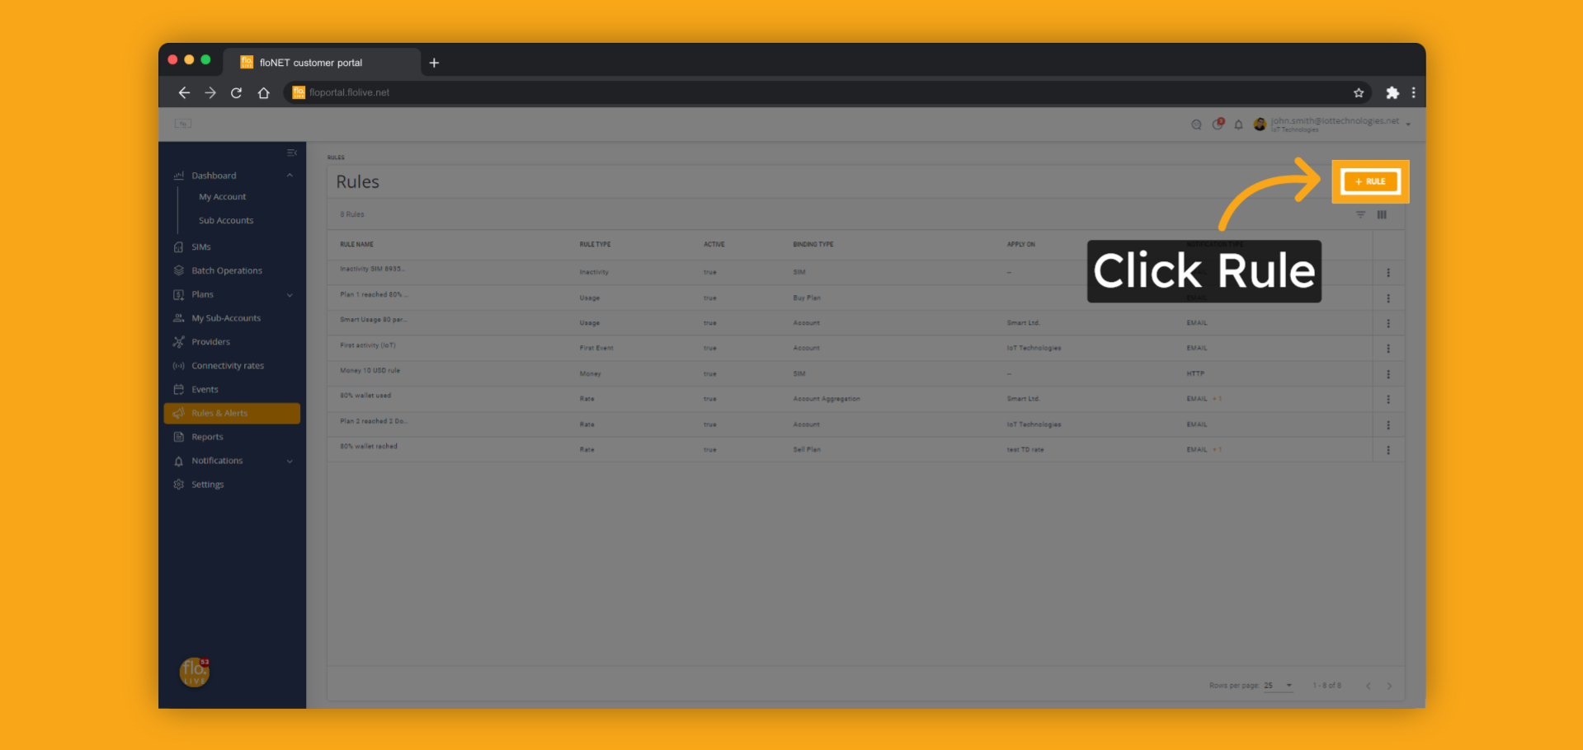
Notes:
Let's review a rule of type Inactivity.
This rule monitors all account SIMs and alerts you when a SIM has not been connected or used data traffic for a defined period of time.
To create a new rule, click on the "New Rule" button.

Slide 24

Notes:
Select Inactivity as the rule type and Account as the binding type.

Slide 25
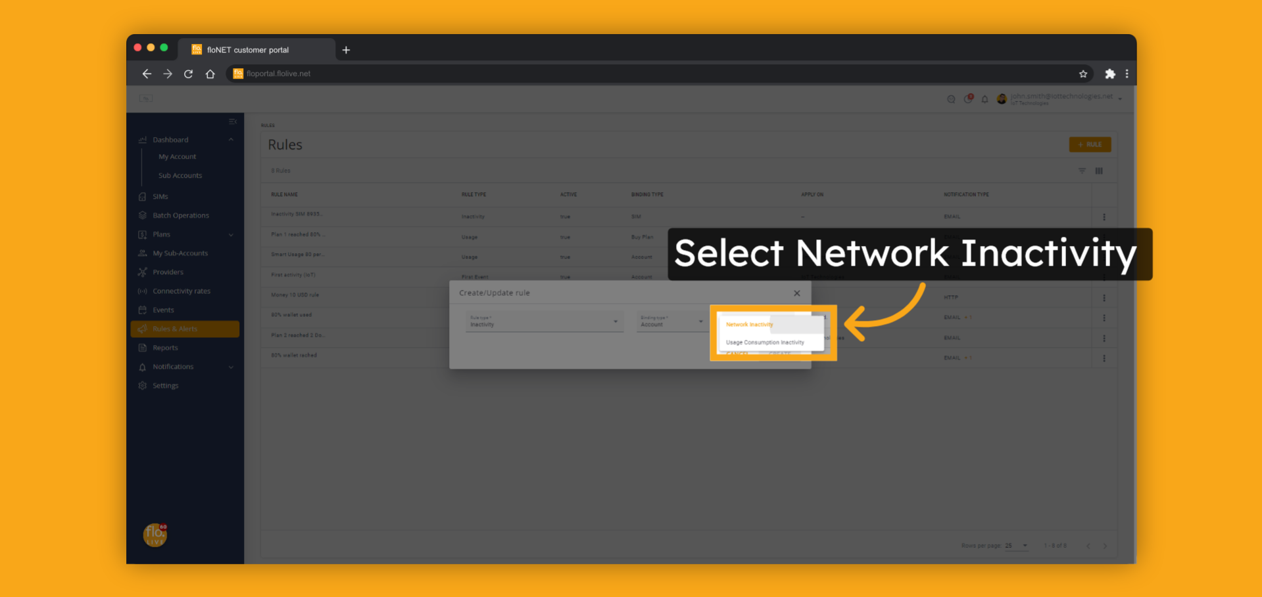
Notes:
Select the Inactivity Type.
You have two options:
"Network Inactivity" - This trigger will activate when the SIM card is disconnected from the mobile network for a specified period of time.
"Usage Consumption Inactivity" - This trigger will activate when the SIM card is not consuming data for a specified period of time.
For this example, we will choose the Network Inactivity option.

Slide 26
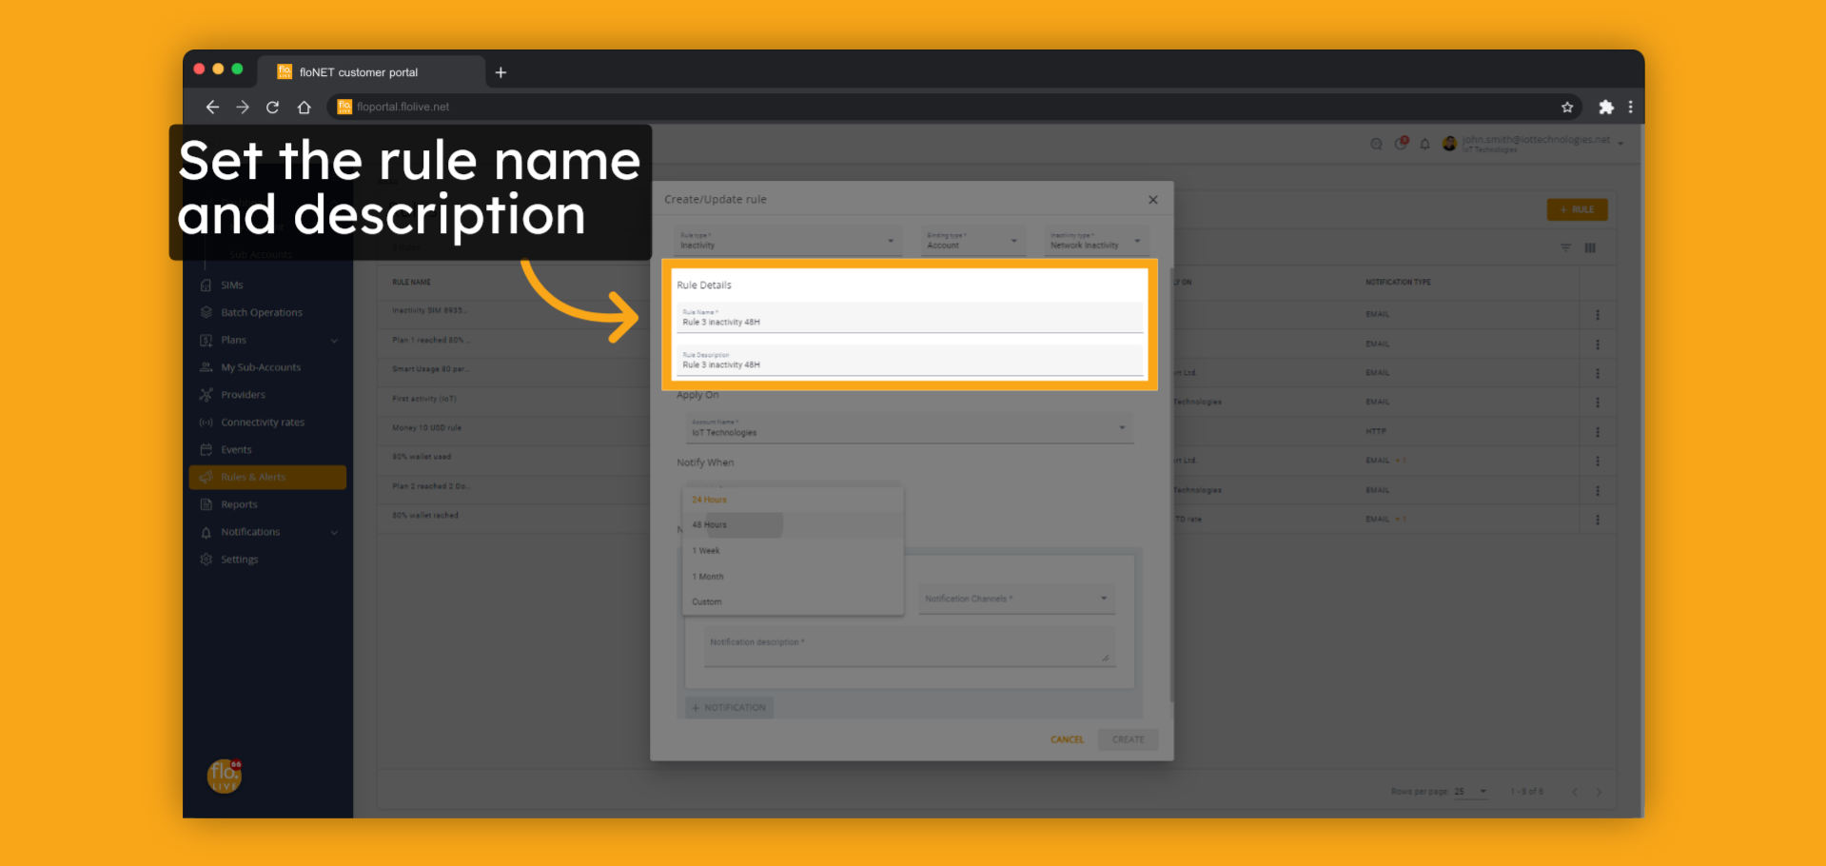
Notes:
Set the rule name and description.

Slide 27
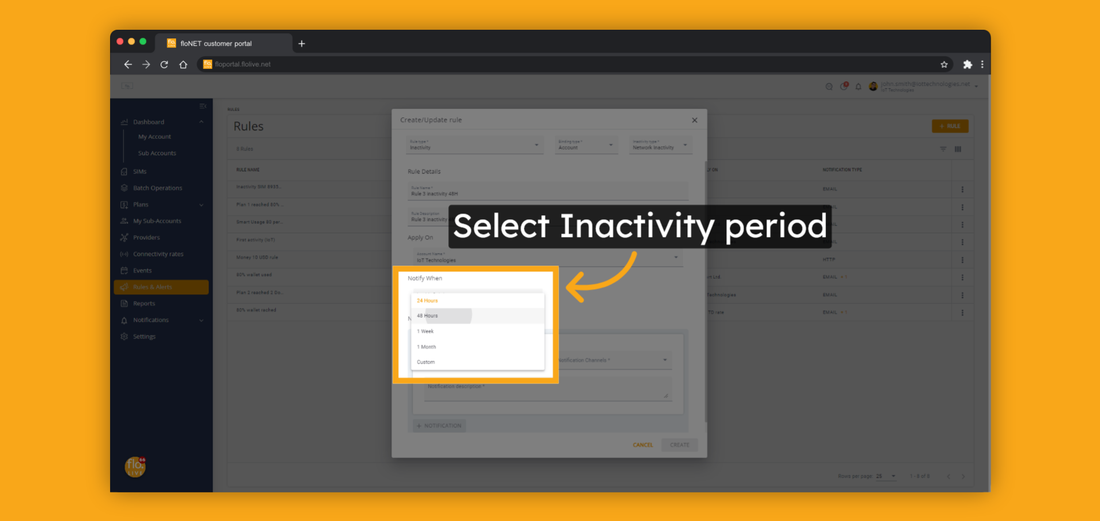
Notes:
Select the inactivity period.
In this example, we will select 48 hours, and the platform shall notify each time it detects a SIM that has lost connection for over 48 hours.

Slide 28
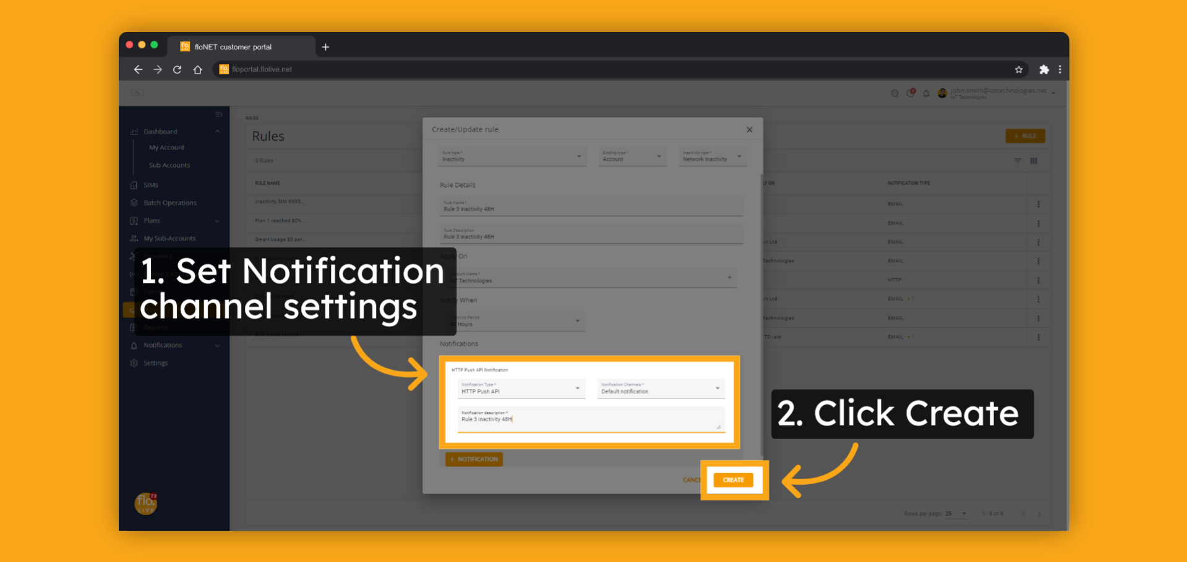
Notes:
Select the notification options and click the Create button.
The rule will become operational immediately.

Slide 29
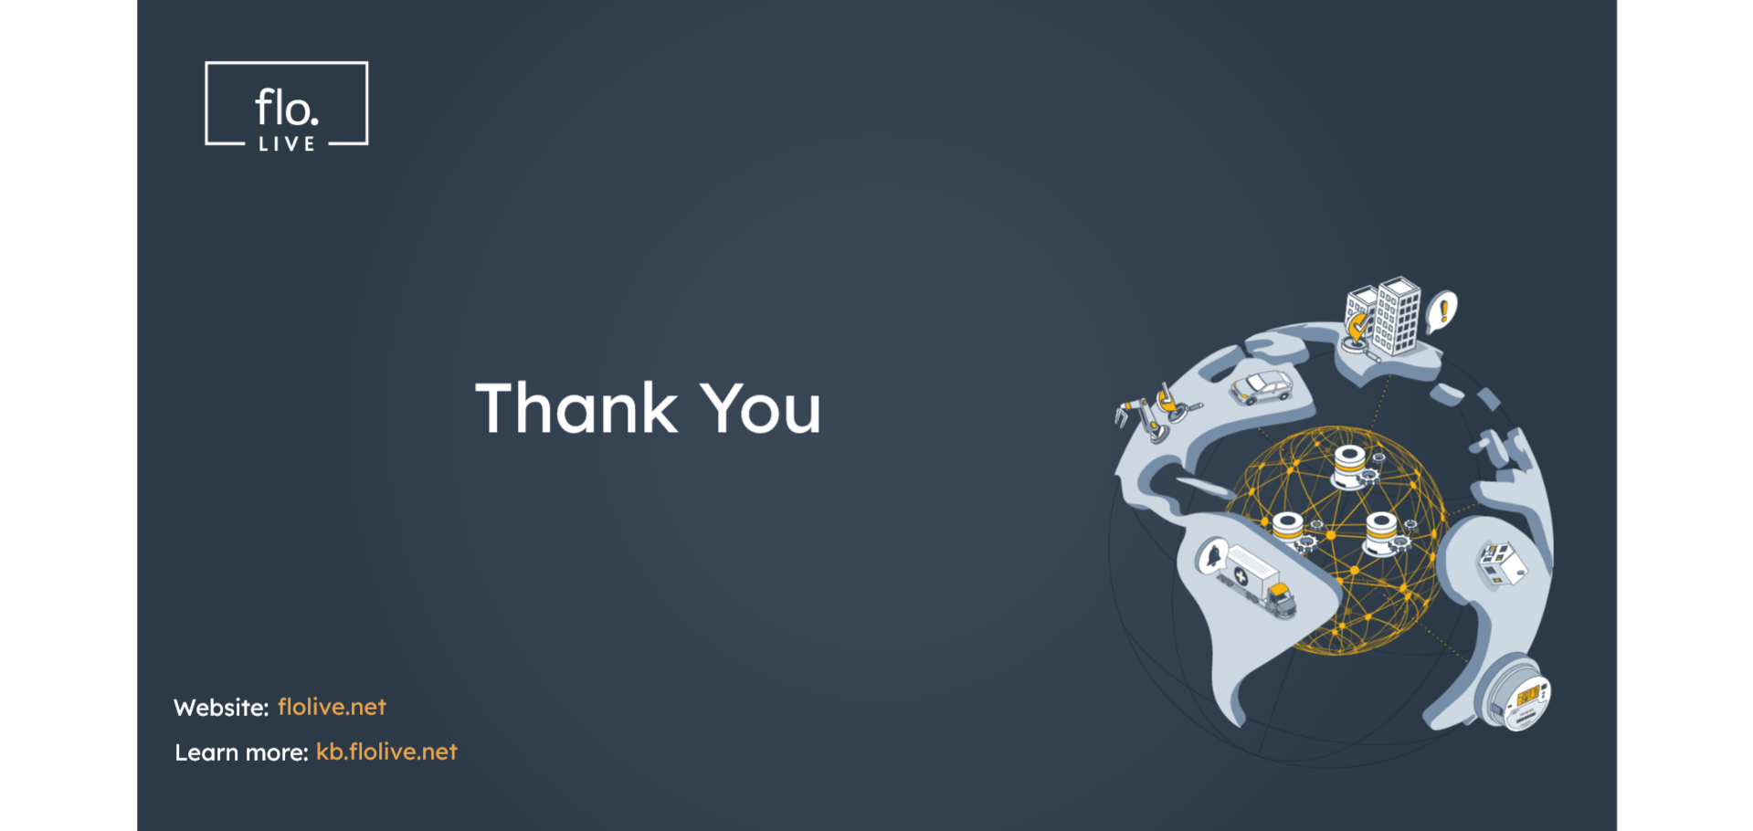
Notes:
Thank you for watching this video, we hope it was helpful.
To learn more about Rules and Alerts visit our floLIVE knowledge center at kb.floLIVE.net.
Join us for additional floLIVE video tutorials available on the floLIVE channel.

